Slide 1
Addressing Persistent Problems in Water and Sewage Management

Slide 2
The team:
Dheeraj D Kamath
Nisarga M V
Prajwal Damodar Prabhu
Srinivas S
Guided by,
Prof. Archana H R
Prof. Surendra H H

Slide 3
Major Challenges faced today
Energy Consumption
Staff
Data Analytics
Portability

Slide 4
What we wish to solve?
The inefficiency today in the monitoring of water and sewage is because of lack of data about
Quantity
Quality
Usage
Our challenge is to build a technology enabled system to monitor quality parameters of the water and sludge discharged by the Sewage Treatment Plants (STPs) and Industrial Effluent Treatment Plants (ETPs) across the city.

Slide 5
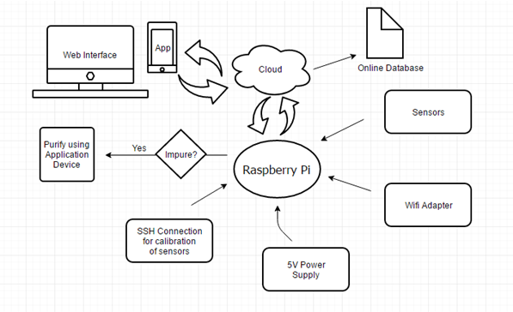
Idea to Proof of Concept

Slide 6
Why Raspberry Pi?
Faster Processing
Smaller
Cheaper
Energy Efficient (5.1V and 2.5A)
Multiple Functionalities
Secure
26GPIO Pins for sensor interfacing
Backup power capabilities

Slide 7
What sensors are we using?
pH Meter
Ammonium Sensor
Total nitrogen measurement
TSS Sensor
Faecal Coliforms
COD
BOD

Slide 8
Prior Work in this field
Monitoring of water level, temperature and pH for suitable conditions for a fish in an Aquarium.
IoT in Irrigation – Automated system for switching pumps ON when the moisture level goes low. Used cloud and API interface.

Slide 9


How do we send values to the cloud?
Cloud Platform:
Server Hosting:
The Raspberry Pi needs a Wi-Fi adapter to connect to the internet.
Code is written to send values to the cloud and it can be accessed by a mobile Application.

Slide 10
Challenges
Provision of internet connectivity
Power Requirements
Compatibilty

Slide 11
How can we solve them?
Equip stations with internet connectivity, internet will be a basic neccessity in near future.
The backup rechargeable battery charges through the AC mains when there is power
The Raspberry Pi supports the interefacing of atmost 26 sensors and hence can be used to interface any type of sensors and other systems remain the same.

Slide 12
Novelty of Approach and Uniqueness
Product for the future – We believe that any project should have a long term impact. Hence, when the internet becomes a basic necessity and everything gets connected to the internet, the product will find utmost importance in the field of sewage treatment
Automated Approach – Does not involve any kind of manual labor and does not require much maintenance
Real Time Data Analytics – Stations are made available with Real time sensor data and they could initiate action whenever there is any dramatic change in effluent values.

Slide 13
Novelty of approach and Uniqueness
Cloud Database – The waste treatment can be monitored for change over a period of time with the rich database collected on the cloud platform
Low Power Consumption – The Raspberry Pi being at the heart of the system has a power consumption of 5.1V and 2.5A, thus making it power efficient
Backup Power – All the Raspberry Pi needs when there is no AC Mains Supply is a Li-Ion Rechargeable Battery as backup power
Easy Handling – Just by the click of the button on the app we could get the status and data from the sensors.

Slide 14
Infrastructure Facilities
Access to Semiconductor, Robotics and Propel Labs which are equipped with basic sensors and varieties of computer boards like AVR, ARM, PIC, 8051, Arduino, Raspberry Pi etc
IoT modules and sensor interfacing kits are also available
College provides funding to certain extent channelised through Technical Education Quality Improvement Programme (TEQIP)
Collaboration with Chemical Department which has several above mentioned sensors.

Slide 15
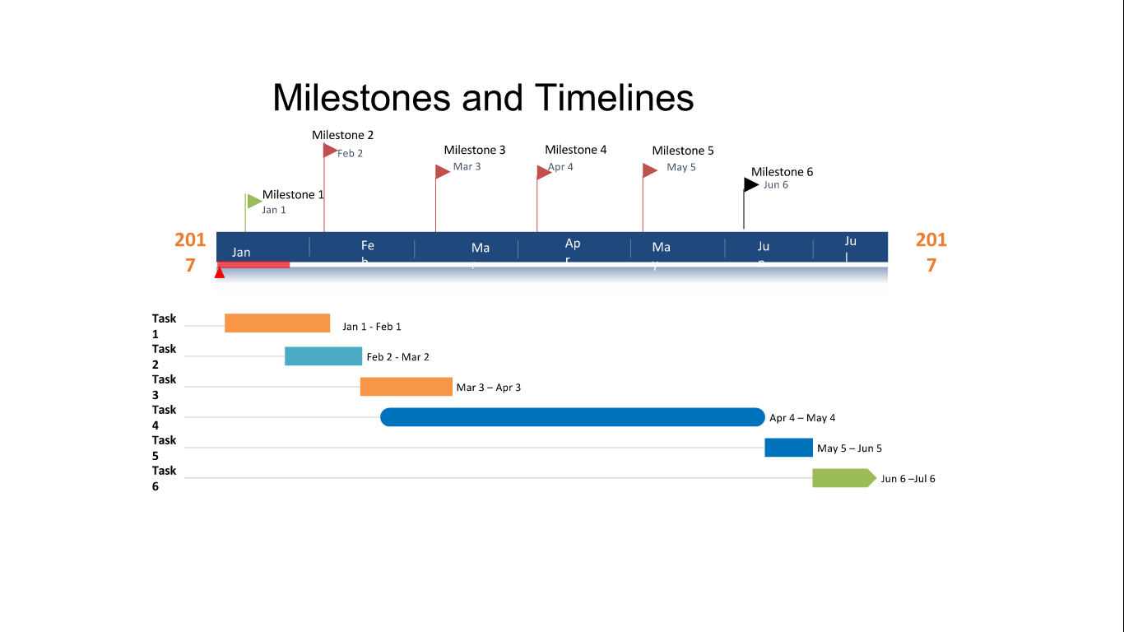
Milestones and Timelines

Slide 16
Budget Break Up with Timeline
Milestones | Task Planned | Duration | Approx. Cost
1 | Detailed study on sensors and procurement of sensors | Jan 1 - Mar 2 | 2,86,000/-
2 | Interfacing the sensors to the Pi | Mar 3 – Apr 3 | None
3 | Data Acquisitions and Transfer to the cloud | Apr 4 – May 4 | None
4 | Prototype Building | May 5 – Jun 5
5 | Prototype Testing | Jun 6 – Jul 6

Slide 17
Plan for testing of the solution in a Real World Setting
We plan to implement our model across the Vrishabhavathi river which was once used as a major drinking water source. At present it receives treated and untreated effluents from treatment plants of Bangalore water supply and sewerage board, containing various organic contaminants, toxic heavy metals etc.
Implementation Steps
Detection and calibrating of the desired water parameters like pH, BOD, COD, NH4-N, N-Total, TSS.
Transferring sensor data to cloud
Transfer of cloud data to the required stations.

Slide 18
Business Plan
Partner with Startup’s or Sewage Treatment Plants across different districts.
Long impact due to implementation of IoT which is the future of everything electronics. Guaranteed Returns.

Slide 19
Thank You!
Any questions?

